Slide 1
MECM Requirement Analysis-v0.9

Slide 2
Requirements v0.9
Num | Content
1 | The map should have the ability to open provinces and cities, China view displays statistical data and alarm info, and the provinces/cities view shows topological data, such as node info, status etc.
2 | Create new node should contain the ability to associate map coordinates, here we will send the position coordinates to backend.

Slide 3
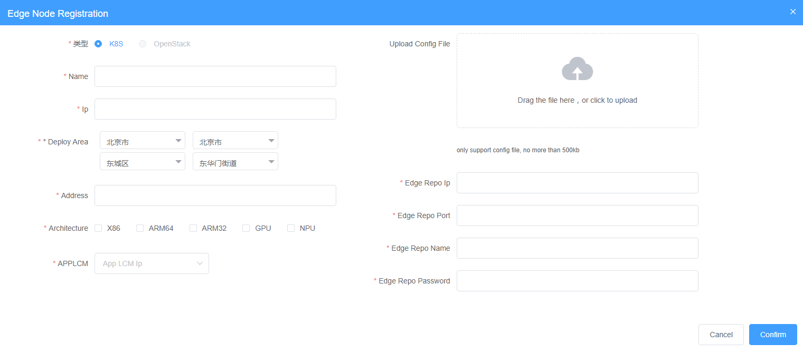

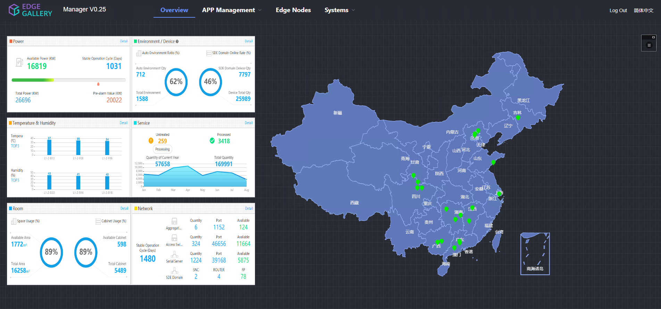
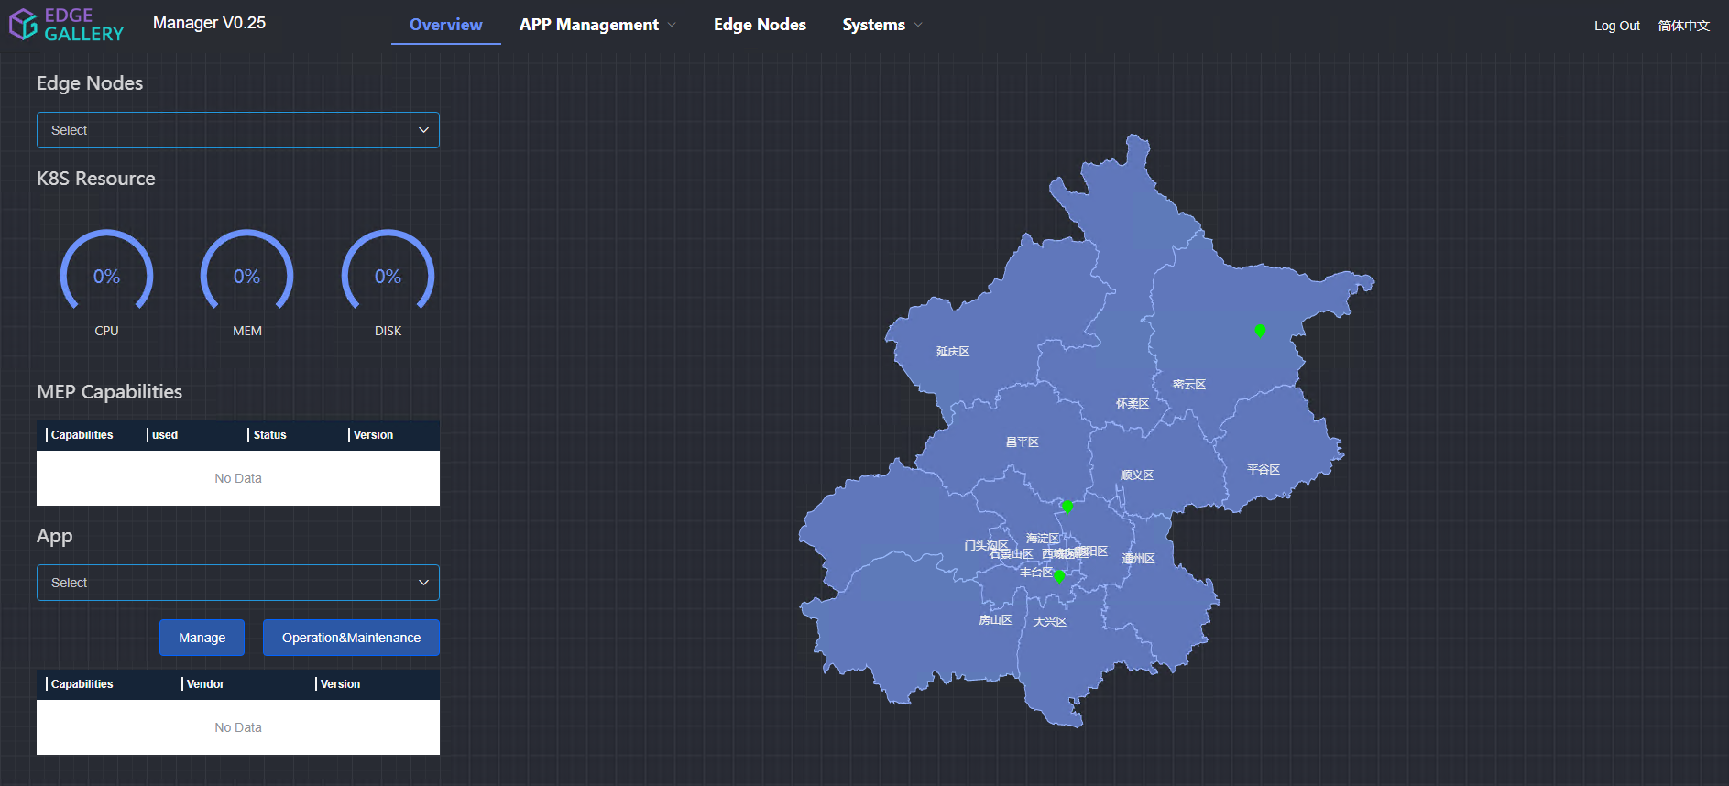
Requirements Analysis v0.9
Node associate coordinates
1.
Create Node
China View
Left part show the warning info and status info
2.
Overview
Province/City View
Left part show the node detail and status info

Slide 4
Security Design Compliance Test
Content | Related Information
Security design rule ID | EdgeGallery security design rule ID, e.g. 1.1
Implementation details | NA
Related APIs | ESR/MEP
Example API payload | NA
Related files | Ks.vue/ Overview.vue
Related GUI URLs | https://daily.mecm.edgegallery.org
GUI testing steps | 1.Enter the node registration page, select position and create node then 2.Enter the overview page, the map will associate the position coordinates 3.The left part of overview page will show the warning info and some status info when we keep the China map view 4.The left part of overview page will show the node info when we switch the china map to province or city view
GUI input example | [110000,110100,110101,110101001]
Additional Info | NA

